Slide 1
Is my classifier confused?

Slide 2

Is my classifier confused?
I’m confident it is yellow
I’m confident it is purple
Uh oh!
Warning! Just because a prediction is made with more confidence does not mean it must be correct!

Slide 3



How far is a point from a set?
Distance of a point $x∈ℝ^{d}$ from a set $S⊂ℝ^{d}$ $d\left(x,S\right)=\min_{z∈S}{d\left(x,z\right)}$
Distance of the origin $0∈ℝ^{d}$ from the hyperplane $w^{⊤}x+b=0$ where $w∈ℝ^{d},b∈ℝ$
$$S$$
$$w$$

Slide 4





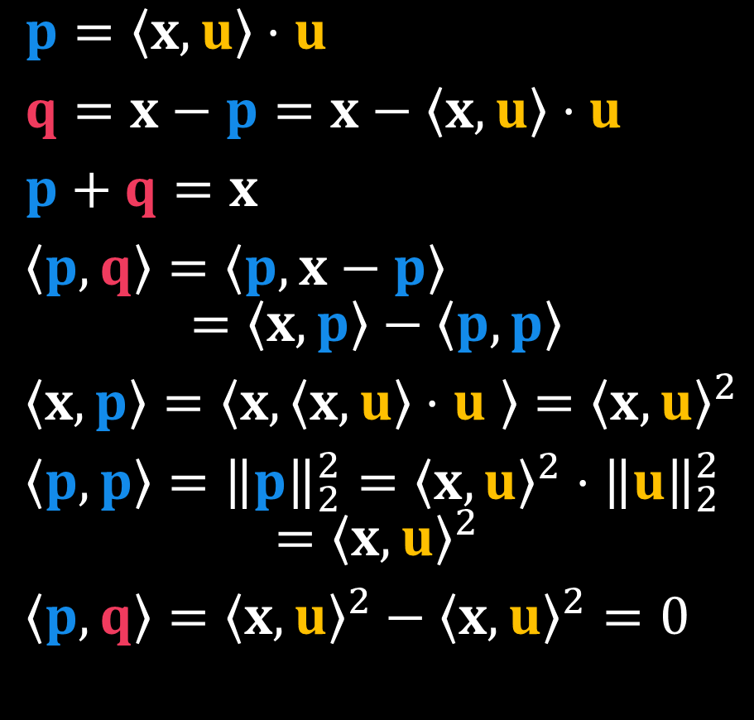








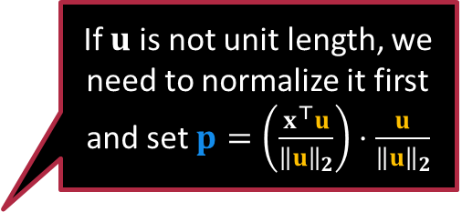
Orthogonal Decomposition
$$x$$
$$x$$
$$q$$
$$x$$
$p=\left\langle x,u\right\rangle ⋅u$
$q=x−p=x−\left\langle x,u\right\rangle ⋅u$
$p+q=x$
$\left\langle p,q\right\rangle =\left\langle p,x−p\right\rangle$ $=\left\langle x,p\right\rangle −\left\langle p,p\right\rangle$
$\left\langle x,p\right\rangle =\left\langle x,\left\langle x,u\right\rangle ⋅u \right\rangle ={\left\langle x,u\right\rangle }^{2}$
$\left\langle p,p\right\rangle ={\left\|p\right\|}_{2}^{2}={\left\langle x,u\right\rangle }^{2}⋅{\left\|u\right\|}_{2}^{2}$ $={\left\langle x,u\right\rangle }^{2}$
$\left\langle p,q\right\rangle ={\left\langle x,u\right\rangle }^{2}−{\left\langle x,u\right\rangle }^{2}=0$
$$q$$
$$q$$
$$p$$
$$p$$
$$p$$
If $u$ is not unit length, we need to normalize it first and set $p=\left(\frac{x^{⊤}u}{{\left\|u\right\|}_{2}}\right)⋅\frac{u}{{\left\|u\right\|}_{2}}$
$$x$$
$$q$$
$$p$$
$$u$$

Slide 5







How far is a hyperplane from the origin?
$v=p+q$ with $\left\langle p,q\right\rangle =0$
$w^{⊤}v+b=0$ means $w^{⊤}\left(p+q\right)+b=0$
Since $w^{⊤}q=0$ this means $w^{⊤}p+b=0$
Pythagoras’ Theorem $‖v{\left.​\right\|}_{2}^{2}=‖p{\left.​\right\|}_{2}^{2}+‖{q\left.​\right\|}_{2}^{2}$ i.e. $‖p{\left.​\right\|}_{2}^{2}≤‖v{\left.​\right\|}_{2}^{2}$ – contradiction!! ☹
Closest point must be parallel to $w$!
Using $v=t⋅w$ and $w^{⊤}v+b=0$ gives $w^{⊤}\left(t⋅w\right)+b=0$ $t⋅‖w{\left.​\right\|}_{2}^{2}+b=0$ i.e. $t=−\frac{b}{‖w{\left.​\right\|}_{2}^{2}}$
$$w$$
$$p$$
$$v$$
$$q$$
Closest point $v=−\frac{b}{‖w{\left.​\right\|}_{2}^{2}}⋅w$
Closest distance$=\frac{\left|b\right|}{{\left\|w\right\|}_{2}}$

Slide 6



How far is a hyperplane from a point $z$?
Change of variables $y=x−z$
Point $z$ becomes the new origin!
Equation of the (same) hyperplane in new variables: set $x=y+z$ $w^{⊤}y+e=0$ $e=w^{⊤}z+b$
Using old formula, distance is $\frac{\left|e\right|}{{\left\|w\right\|}_{2}}=\frac{\left|w^{⊤}z+b\right|}{{\left\|w\right\|}_{2}}$
$$w$$
$$p$$
$$v$$
$$z$$
$$q$$

Slide 7




Exercise
$$c$$
$$r$$
Find the distance of $z$ from the ball $ℬ\left(c,r\right)≝\left\{x:{\left\|x−c\right\|}_{2}≤r\right\}$
First, try to do this when is $z$the origin
Decompose along and perpendicular to $c−z$
Find out why this trick does not work for ellipses, e.g., when $z=0$ and the ellipse is $ℰ≝\left\{x:\frac{{\left(x_{1}−2\right)}^{2}}{4}+{\left(x_{2}−1\right)}^{2}≤1\right\}$ where $x ∈ℝ^{2}$
The closest point does not lie along the line joining the origin and centre of ellipse any more ☹
$$z$$
3
2
this is the closest
not the closest
c
1
c
0
0 1 2 3 4

Slide 8
Have fun!
Join us next time.

